Slide 1
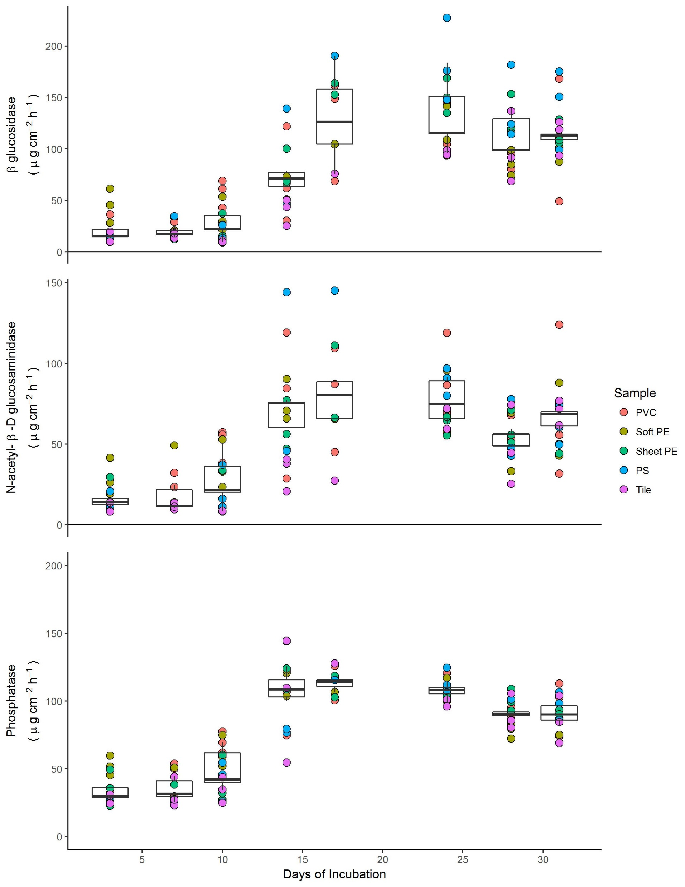
b
c
a
b
c
b
a
b
a

